Slide 1
AGILERS
ALEX GABRIEL ILL LEET EXPENSE REIMBURSEMENT SYSTEM
Engineered By Alex Johnson AND GABRIEL ZAPATA

Slide 2

Target Market
Revature
and Revature ONLY
Adopt us over your current ERS solution!

Slide 3
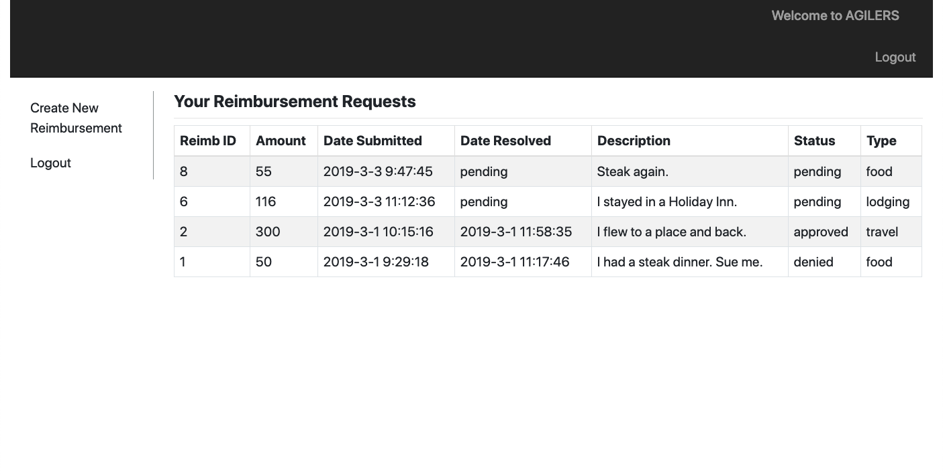
Why Agilers?
Most efficient
Most aesthetically pleasing layout and design
The illest, leetest ERS solution on the market

Slide 4
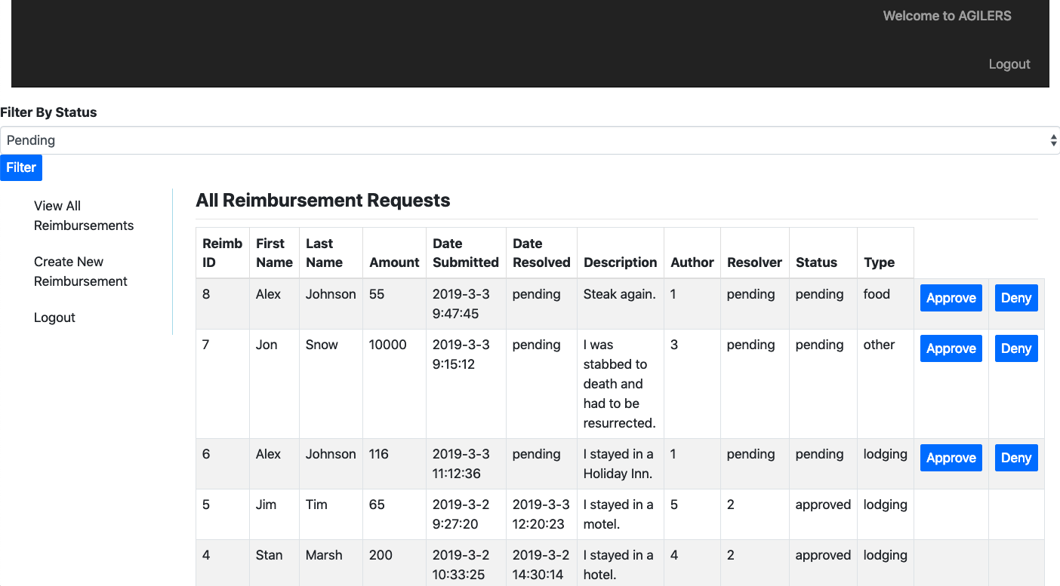
Now For A Site Demonstration…

Slide 5

Sample Code
Store entered username when login button clicked
1st argument: given item name
2nd argument: item to target
Saves to window’s local storage
Context: within function triggered by click event

Slide 8
Thank you for your time! Any Questions? AGILERS
Engineered By Alex Johnson AND GABRIEL ZAPATA

